Slide 1
Forecasting GDP Growth How Can Machine Learning Improve Predictions in Economics?
Group 6
Averina Quak Xue Min
Chang Sun
Hou Chen Ying @ Hou Jenny
Natalie Christyfera Yu
Sng Yi Xuan

Slide 2
Table of Contents
01
Business Opportunity
02
Proposed Approach
04
CART Model
EIU’s Current Method, Value of Machine Learning
Process & Analysis
05
Analysis of Results
Variables Used, Data Extraction, Data Cleaning
Linear Regression vs CART Model
03
Linear Regression
06
Future Works
Process & Analysis
Current Limitations & Future Directions

Slide 3
01
Business Opportunity

Slide 4
Business Problems
Purpose
Solution
Achievement
Forecasting and advisory services for entrepreneurs, financiers and government officials in decision making.
Forecasts of political, policy and economic conditions.
Understand the current and future positions of a country.
Estimates of important economic indicators.
Future outlooks of the country.
Notes:
First and foremost, let me quickly explain what is Classification and Regression Tree? As the name suggests, it uses a decision tree to go from observations about an item, for example, a country’s means years of schooling (represented in the branches) and unemployment rate, to conclusions and predictions about the country’s real GDP growth as represented in the leaf node. In a decision tree, leaf nodes represent the prediction while the branches represent conjunctions of features that lead to your prediction.

Slide 5
Methods and Opportunity
Current Methods
Business Opportunity
Growth Regression with determinants:
The availability of an educated workforce
GDP per worker
Life Expectancy
The quality of institutions
Fiscal policy
Government regulation
Movements in the population of working age relative to the overall population
The development of information and communication technology infrastructure
Limitations:
Social and environmental factors.
Current set of variables may not be all-encompassing.
Possible solutions:
Including more variables:
Reasonably affects GDP
Promote a more optimal combination of variables that can better predict real GDP growth.
Notes:
The null hypothesis: Whether the

Slide 6
How Machine Learning differs from Analytics Models
Machine Learning
Exploring the algorithm learnt from data automatically.
Construct and improve the model without any human intervention.
Make predictions for the future.
Data Analytics:
Obtaining insights from current data through data processing measures.
Higher chance for business to enhance the decision-making system.
As a whole, data analytics focuses on extracting any valuable information and obtaining insights from currently available data, whereas machine learning focuses on computing and training algorithms with the data for automatically functioning in the prediction on future business activity.

Slide 7
Demand forecasting
Demand sensings
Predictive analytics
Success Stories
Machine Learning and AI are expected to minimize the mispredictions that happen when assumptions are coupled with unforeseen occurrences.
Based on these precise predictions
Forecasts are utilized to construct greater strategies based on those precise predictions
Oxford Economics
Databases
Publications
analytical tools
Economic risks on the investing strategy via scenario planning.
Likely effects on their national, municipal, and regional markets.
Include random events such as Brexit, policy changes, evolving consumer habits, or a recession.
Navigate through global crises by discovering challenges and opportunities for their firms.
“new market evaluation”
Tracking and analysing global trends in countries, industries, cities, and tourism.
determine top locations that would give the most potential for their firms to flourish.
Notes:
Oxford example

Slide 8
Value of Machine Learning to EIU
Help to enhance their product, through automation and continual learning of the Machine Learning model.
Social and environmental factors included
Identifying significant factors of GDP growth
Better understand the strengths and weaknesses of a country or region therefore make better informed decisions
Stay ahead of your competitors
Improving the value proposition to your customers
Remaining as the preferred choice for economic insights.

Slide 9
02
Our Proposed Approach
Notes:
[Slide] Thanks Chang Sun. With the great opportunity highlighted previously, you must be wondering how exactly can EIU utilise ML? Well, my group has gone through the journey to help you identify suitable techniques and variables to use to improve EIU’s forecasting methods. I’ll now be walking you through the group’s approach.

Slide 10
Proposed Approach
Presenter: Averina
Data Processing
CART
Data Extraction
Data Cleaning
Compare against EIU’s Baseline Model
Identify
Linear Regression
Analysis
Variables &
Factors
Compare against EIU’s Baseline Model
Evaluation of Outcomes
Notes:
[Slide] We first identified variables & factors that will be included in our models. After which, we will extract these data and clean them before moving to our chosen Machine Learning Models. Which are Linear Regression and CART. At the end of it, we will compare and evaluate the outcomes of both models and provide suggestions and learning points.
.

Slide 11
Variables
EIU’s Variables
New Variables
Presenter: Averina
Market Size
Inflation
R&D Expenditure
Life Expectancy
Gross National Income
Human Development Index
Mean Years of Schooling
Balance of Trade
Gini Coefficient
Internet Penetration
Logistics Performance Index
Child Mortality Rate
Variables that have certain relation & influence on economic growth
Government Indicator
Widely-used appropriate indicators which serves as a baseline
Environmental Performance Index
Corruption Performance Index
Trade Openness
Political Stability
Urban Population
Labour Force
Renewable Energy
CO2 Emissions
Domestic Credit to Private Sector
Industry Value Add
Unemployment Rate
Global Competitiveness
Index
Notes:
[Slide] To start, our chosen variables include both EIU’s current variables and new independent variables. As EIU’s variables are widely used indicators that are appropriate in predicting real GDP growth, it serves as a baseline for comparison. For these variables, we have chosen best replacements for those that we were unable to attain the original dataset. Such as replacing healthy life expectancy in EIU’s model with life expectancy. Apart from that, numerous new variables have been chosen as they have certain relation & influence on a country’s economy, hence we hope to explore their importance in predicting real gdp growth. We decided to go with a large number of choices as the process of training our models will filter out the statistically significant and important variables

Slide 12
Factors
Presenter: Averina
Countries
Countries
Took 60 randomly chosen countries from EIU’s list
Took 20 randomly chosen countries in the Asia Continent as they could have more similarities in variables
Years
Years
Across 10 years to reduce impact of random phenomena from a year on the model
Across 10 years to reduce impact of random phenomena from a year on the model
Notes:
[Slide] After the identification we’ll look at the factors namely countries and years to include. Our initial approach took 60 randomly chosen countries from all around the world in EIU’s list to obtain a balanced and large dataset. We also took it across 10 years to reduce the impact of random, unexpected events on training our model. This is also the reason we did not include 2020’s data due to the impact of COVID-19 on every country’s gdp.
However, after further data exploration, we realise that countries across the world achieve their GDP differently. Hence the importance of variables differs from country to country in their gdp growth. With that, it would cause our trained model to be inaccurate and not useful. Thus, we pivoted to choosing a specific region, namely the asia continent where we randomly selected 20 countries within the region as these countries could have more similarities in their variable importance and contribution to gdp growth. We continue to take data from across 10 years to ensure a reliable dataset.

Slide 13


Process
Data Extraction
Data Cleaning
Presenter: Averina
Extract needed data from online reliable databases into final spreadsheet (specific to countries & years)
Removing NAs, converting into proper datatypes & Feature Scaling
Notes:
[Slide] After the selection of variables and factors, data extraction and cleaning was conducted. Data was extracted from reliable online sources such as World Bank and International Monetary fund, whereas our data cleaning involved removing Nas, converting into proper datatypes and feature scaling. I’ll now dive deeper into the codes to explain our process.

Slide 14


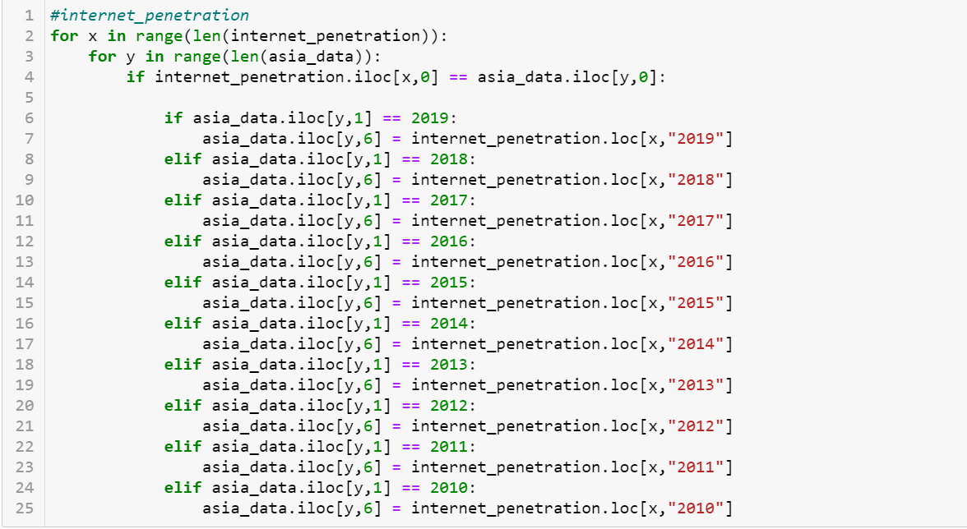
Data Extraction
Presenter: Averina
Pandas library
Using pandas to read CSV into dataframes for easy manipulation & cleaning
Pd.read_csv()
Reading downloaded datasets for respective variables for extractions
Index Location & Label Location
Using iloc & loc to extract specific data for countries and years and combining them into our final spreadsheet
Notes:
[Slide] Firstly, for data extraction, we utilise pandas library to read the various CSV data files into dataframe for easy manipulation and cleaning. After downloading the CSV files from online sources, the read_csv function was utilise to read them into dataframe for further extractions. To extract specific data for countries and years for a certain variable, index location and label location were utilise to allow us to fill in and combine data into our final spreadsheet. This step was repeated for all the variables with minor changes to the codes to adapt to the format of the downloaded CSV files.

Slide 15
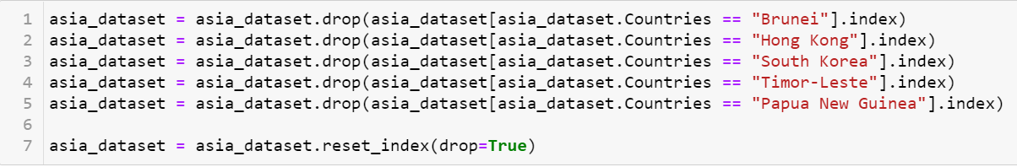
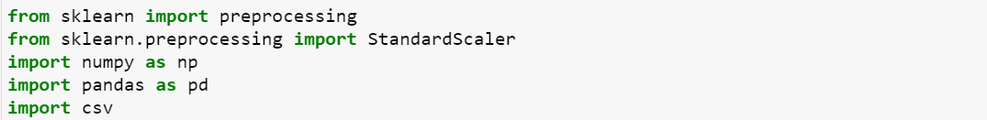
Data Cleaning
Presenter: Averina
Functions used from Pandas: iloc, is.na(), .drop()
Remove Variables
Drop variables with > 80% missing data
Remove Countries
Drop countries with > 2 variables with 10 years worth of missing data
Conversion of Data Types
Convert all datatypes of variables to numeric
Feature Scaling
With sklearn package, independent variables are normalised and standardised
Notes:
[Slide] Afterwhich, the final spreadsheet had to undergo data cleaning to handle inconsistencies in data to develop a reliable machine learning model. We removed variables with more than 80% missing data such as r&d expenditure and drop countries with more than 2 variables with all years missing data such as Brunei. Conversion of data types to appropriate types are crucial to ensure consistency, hence we converted all datatypes to numeric since they were numeric variables.
Lastly, Our dataset deals with several different indicators, all of which have varying degrees of magnitude, range and units. In order for our machine learning models to interpret these features on the same scale, we perform feature scaling, namely Normalization and Standardization. Where we will fit our models to raw, normalized and standardized data and compare the performance for best results. The CART model uses decision rules and split thus it does not require feature scaling.

Slide 16
Presenter: Averina
Models & Evaluation
Linear Regression
EIU Baseline Model
Comparison of Models
CART
Notes:
[Slide] From the datasets obtained, we will conduct linear regression and CART to identify the best model. As we were unable to obtain the exact datasets for certain variables used in EIU’s regressive model, we chose good replacements, thus directly comparing to EIU’s current model would not be a fair comparison. As such, for both methods, we created an EIU baseline model with only the variables that EIU is currently using for a fair analysis of results. After comparing to the baseline model, we will also be comparing both models and analysing the results. These will be further elaborated by Jenny and Yixuan. I’ll now pass on my time to Jenny.

Slide 17
03
Linear Regression
Notes:
Thank you Averina, I am Jenny and I will be sharing on how we created our Linear Regression model and demonstrating it on the datasets that we have.

Slide 18
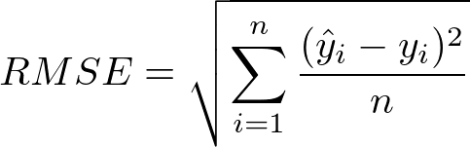
Presenter: Jenny
Linear Regression
Linear Regression models a relationship between a continuous Y variable and its X variable(s) by fitting a linear equation to observed data. The relationship is then used predict the value of the Y-variable based on given predictor variable(s).
Root Mean Square Error
=
for Continuous Y
Notes:
A brief introduction to Linear Regression, it’s a linear approach for modelling the relationship between a continuous dependent variable and one or more independent variables. This relationship can then help us predict the continuous dependent variables given a dataset of the independent variables.
And for our continuous Y, model evaluation criteria used to judge predictive performance is RMSE, which is not limited to application in Linear Regression.

Slide 19
Presenter: Jenny
Linear Regression Models
EIU Baseline Model
Full Standardized Data
EIU variables with our own data
EIU variables + our additional variables
Feature Scaling
Used STANDARDISED DATASET
Good practice to conduct feature scaling on data used for machine learning
x-variables in the raw dataset had differing ranges of values as well as measurement units
Avoid the bias that came with this
Notes:
As explained by Averina, for a more fair baseline of comparison, we will perform Linear Regression on our own iteration of EIU’s model and again on our full dataset.
One thing to note is that for linear regression, for our feature scaled data, we went with standardized data. This was important for machine learning as we wanted to avoid biases that might come with using our raw data.

Slide 20
Presenter: Jenny
LIVE DEMO
Notes:
Now that the explanations are out of the way, I will be going through our process of creating the model by giving a live demonstration.

Slide 21
Presenter: Jenny
RMSE b/w Train-Test Sets
Notes:
Before comparing the RMSEs we retrieved from both models, we need to see whether the model complexity and predictive error are well-balanced. This we determine from the similarity in RMSE of train and test set. Since the RMSE of train and test sets can vary with different splits or seeds, we accept the model as long as they are similar and aren’t too over or under-fitted.

Slide 22
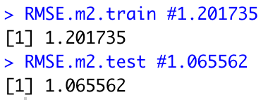
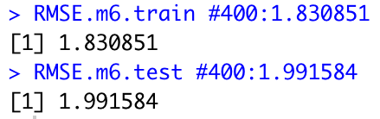
Presenter: Jenny
RMSE b/w LR Models
Full Standardized Data
EIU Baseline Model
<
Notes:
Both models had similar RMSE’s between the train and test sets and since our RMSE value for the test set is smaller than that of the EIU baseline model, showing improvement in accuracy, we concluded that that our RMSE value was acceptable.

Slide 23
Presenter: Jenny
What we can Infer
Trade Openness
Labour Force
Domestic Credit to Private Sector
Inflation
Child Mortality
Urban Population
CO₂ Emissions
Industry Value-Added
Unemployment Rate
Market Size
Mean Years of Schooling
Trade Openness
Labour Force
Domestic Credit to Private Sector
Variables Left in EIU Baseline Model
Variables Left in Full Dataset Model
Notes:
This improvement in model shows us there are added variables that can theoretically be adopted by EIU to improve GDP Growth Prediction. Namely, from the remaining variables in our model, Inflation, Child Mortality and so on can be considered.
But more importantly, this improvement shows Machine Learning can indeed contribute to EIU as a business.

Slide 24
04
CART Classification & Regression Tree

Slide 25
Presenter: Yi Xuan
What is CART?
A Classification and Regression Tree (CART), is a predictive model, which explains how an outcome variable's values can be predicted based on other values
Age
Root Node
Yes
No
<30
BMI
Exercise
Branches
Yes
No
Yes
No
Leaf Node
<23
Fit
Unfit
Fit
Unfit

Slide 26
Presenter: Yi Xuan
LIVE DEMO

Slide 27
Presenter: Yi Xuan
Iterations of Datasets
Dataset | No. of Branches | Trainset RMSE | Testset RMSE | Difference in RMSE
Original | 5 | 1.131 | 1.839 | 0.708
< 10 NAs | 6 | 1.068 | 2.589 | 1.521
No NAs | 4 | 1.237 | 1.803 | 0.566
Using Mean | 2 | 1.400 | 2.157 | 0.757

Slide 28
Presenter: Yi Xuan
Comparison to
EIU Baseline Model
Government Indicator
Government Indicator
Mean Years of Schooling
Means Years of Schooling
Child Mortality Rate
Life Expectancy
EIU
Our Model
Gross National Index
Market Size
Trainset RMSE: 1.131
Testset RMSE: 1.839
Difference: 0.708
Market Size
Domestic Credit to Private Sector
Trainset RMSE: 0.807
Testset RMSE: 2.236
Difference: 1.430
Life Expectancy
Trade Openness
Unemployment Rate
Internet Penetration
Human Development Index
Labour Force
Industry Value Add

Slide 29
05
Analysis of Results

Slide 30
Presenter: Yi Xuan
Insights Gained
Linear Regression
CART
Optimal
Train RMSE: 1.20
Test RMSE: 1.07
EIU Baseline
Train RMSE: 1.83
Test RMSE: 1.99
Optimal
Train RMSE: 1.13
Test RMSE: 1.839
EIU Baseline
Train RMSE: 0.807
Test RMSE: 2.24
Child Mortality
Industry Value Add
Child Mortality
Industry Value Add
Unemployment Rate
Inflation
Unemployment Rate
Gross National Index
Urban Population
Human Development Index

Slide 31
06
Future Works

Slide 32
Presenter: Natalie
Limitations
Existence of cross-national differences
Variables were from various countries
Every country has different economic conditions
Different motivations to promote economic growth across countries
It would be quite arbitrary to include the data from different countries altogether to train the model for predictions of the final GDP growth.
Obstacles in data collection
Insufficient data available over 20 years or above in records for countries we have taken into account
Compromise to count only 10 years records alternatively
May have obtained a more optimised and desirable model accuracy if the training set had been expanded

Slide 33
Presenter: Natalie
Limitations
The data-preprocessing for missing values
Linear Regression Model
Elimination of the countries that had too many missing values
Model could have been more comprehensive and robust if we had the dataset for those deleted variables to train our model
More valid predictor variables may exist
Possibility of more variables that are relevant but were undiscovered due to time constraints

Slide 34
Presenter: Natalie
Future Plans
Add other indicators
Expand their services
Pilot Studies
Teaching Hub
Use Machine Learning
Unemployment rate and industry value add
Integrate these into their flagship report
Learning materials for students, analysts and researchers
Have a global team of experts ready to give consultations to customers
Trade-offs between fairness
Interpretability of models
Inconsistencies within data collection
Provide data for global industry services
Daily publications, research & analyses, and articles (Eg. Coal index for daily tracking)

Slide 35
Presenter: Natalie
Pilot Studies
Trade-offs in fairness in predictive algorithms
How algorithms promote discrimination eg. Hiring
Affects unemployment in a country
Case study – Amazon
Analysed CVs submitted to the firm over a period of 10 years (train set) and learned that male applicants were favoured
Demoted women’s CVs for STEM job positions
CVs that had the term “women” like in “Women’s Rugby Union” were penalized
Immediately rejected all female applicants from 2 specific all-girls’ colleges
Company has low female to male ratio, thus the algorithm identified being a male as a success factor
Algorithm gained undesirable human traits such as prejudice and discrimination
Pre-existing prejudice in recruiting tools may affect unemployment and economic growth of a country. EIU coulr develop pilot studies such as
How to ensure that algorithms promote equity?
What kind of fairness is favourable? (eg. How to equalise Type I and II errors among males and females?)

Slide 36
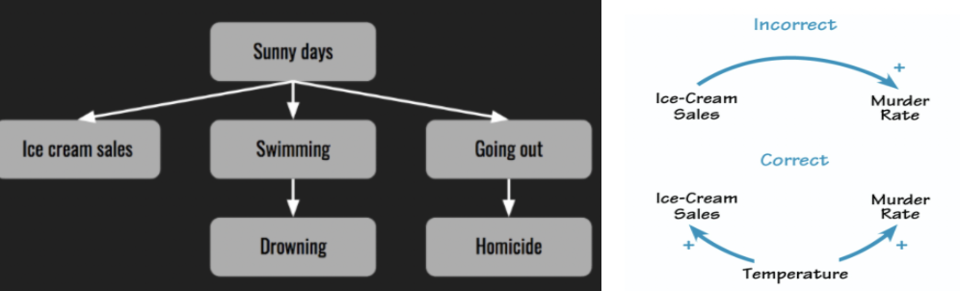
Presenter: Natalie
Pilot Studies
Interpretability of models
Correlation does not imply causation
Eg. Ice cream sales and murders in the US has a positive correlation, but they do not have a causal relationship
May not be as obvious in more complicated topics
EIU could consider pilot studies to better understand correlation vs causation between independent and dependent variables
How to determine better correlation between variables?

Slide 37
Presenter: Natalie
Pilot Studies
Identification and evaluation of inconsistencies in data collection
Worldbank is considered a credible source for datasets–but there are still limitations
Differences due to data collection process
Reflected value might not accurately represent real values
Different countries have different methods, procedures and motivation for collection of raw data
Different criterias are followed to calculate or measure the predictors across different countries
Pilot studies can be aimed at spotting these inconsistencies and an evaluation can then be made to study their impact on machine learning algorithms.

Slide 38
Thank You!

